Slide 1
Group 10 HW3 for Digital Economy & Decision Analytics
Shaoyuan Xia
Jiayi Cong
Danni Luo
Team NO.10

Slide 2
Outline of July 10 HW
create a N (mu, SIGMA), try in a rotating plot in 3D
Redo the LDA example lRTG1792

Slide 3
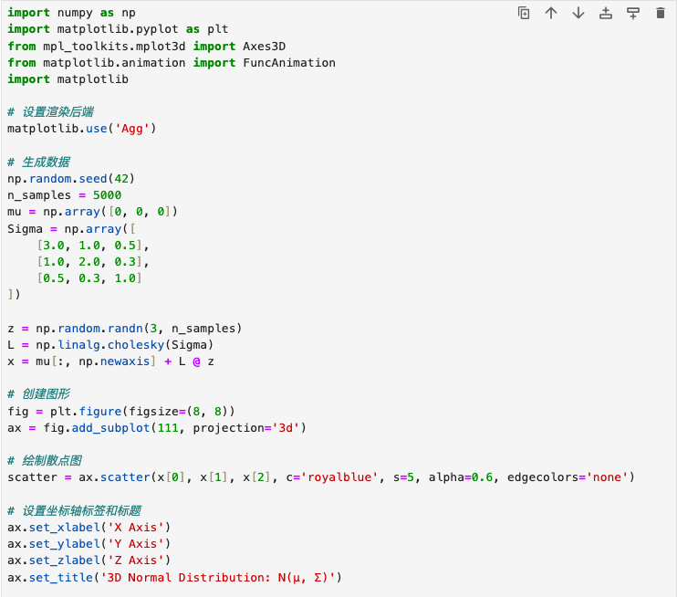
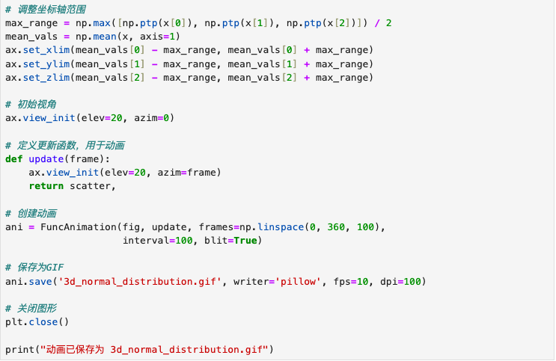
1. Code for creating a N( μ, Σ ) and its rotating plot
method 1: generate a rotating animation GIF

Slide 4
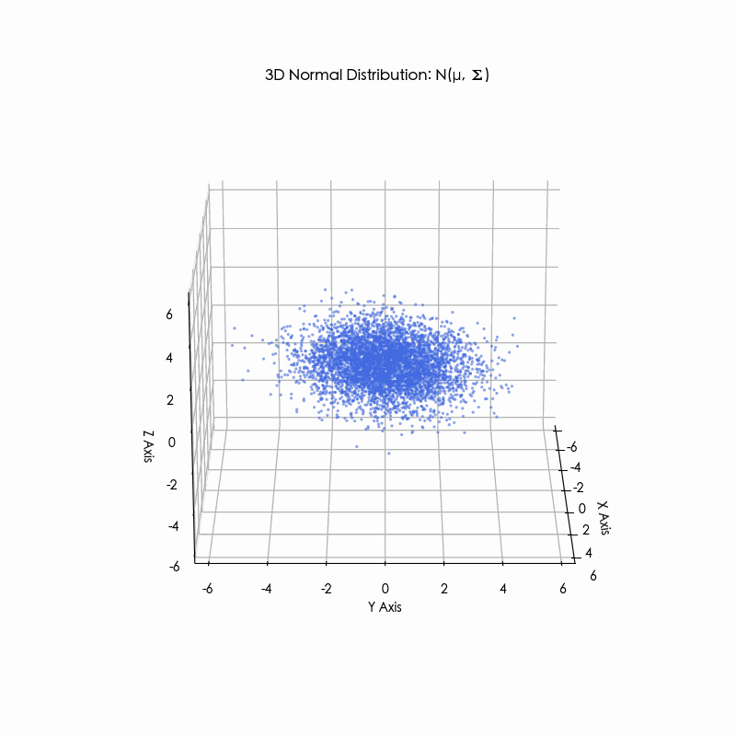
A rotating plot for N( μ, Σ )

Slide 5
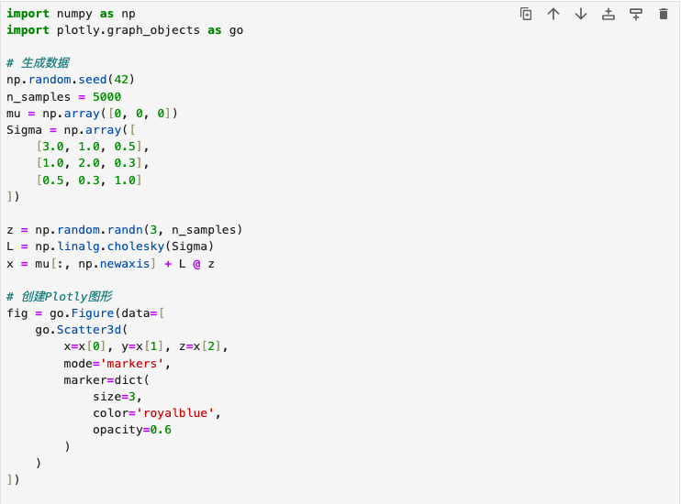
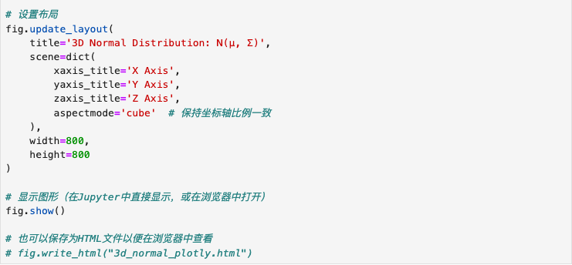
1. Code for creating a N( μ, Σ ) and its rotating plot
method 2: implementing interactive 3D graphs using Plotly

Slide 6
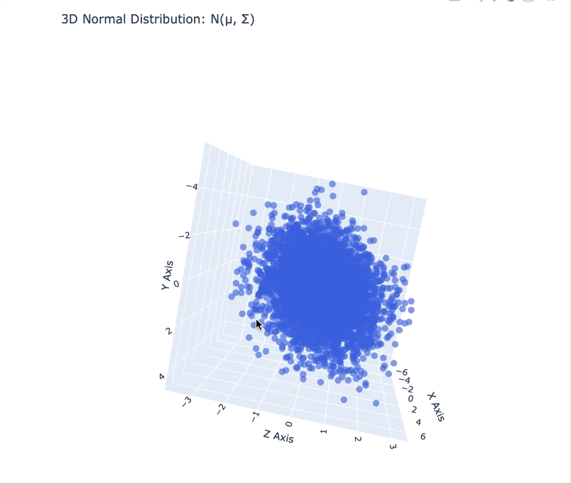
A rotating plot for N( μ, Σ )

Slide 7
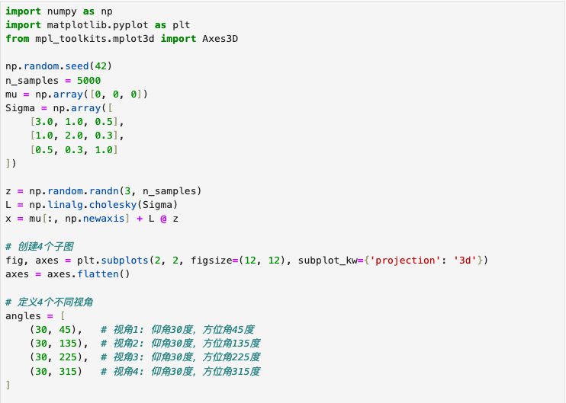
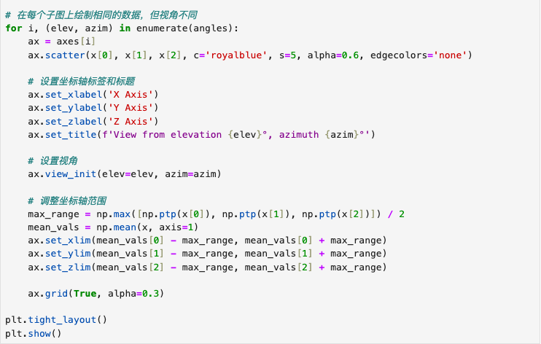
1. Code for creating a N( μ, Σ ) and its rotating plot
method 3: generate static multi-angle views

Slide 8
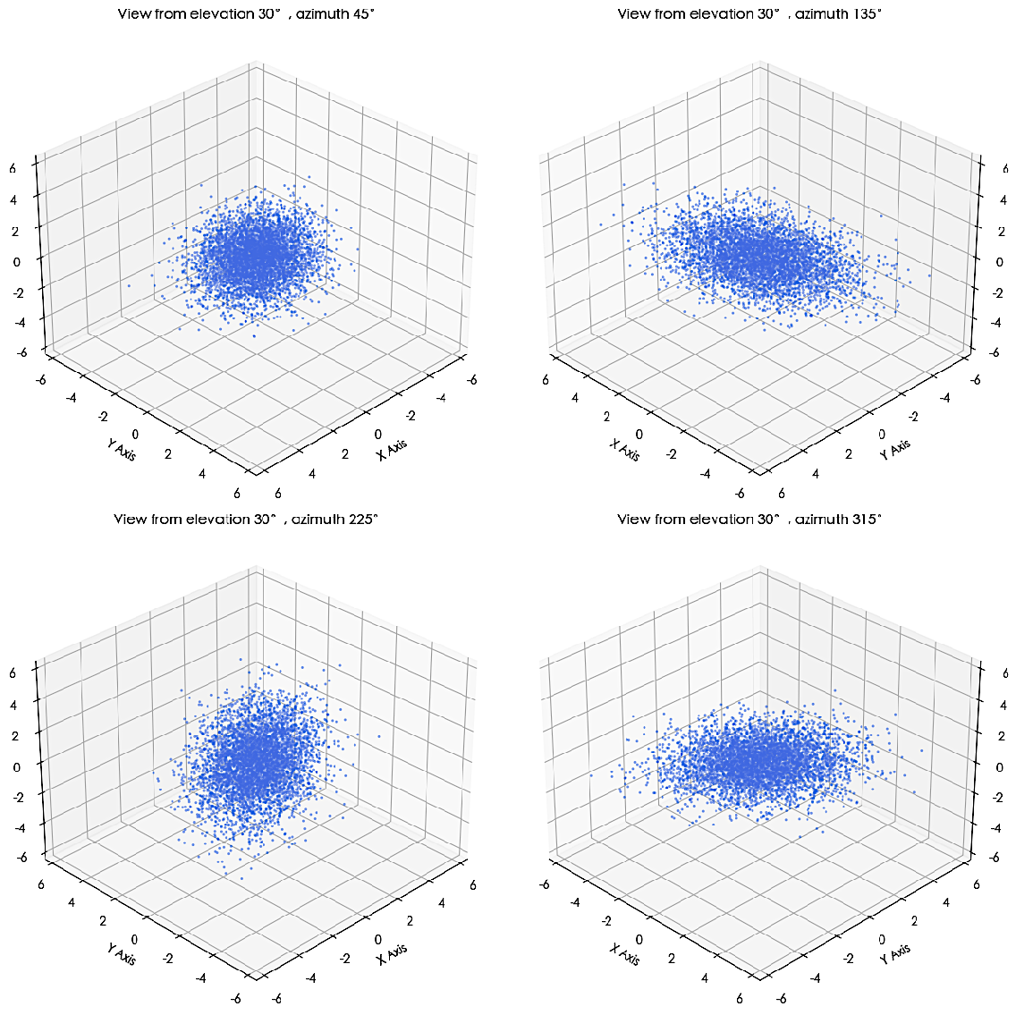
A rotating plot for N( μ, Σ )

Slide 9
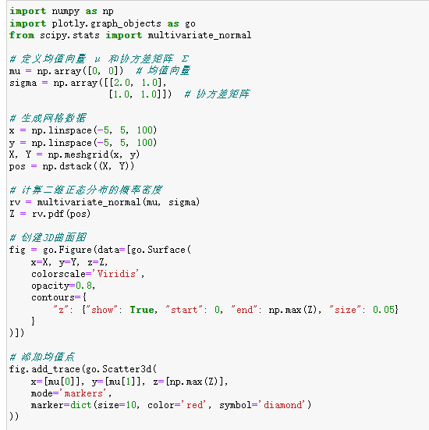
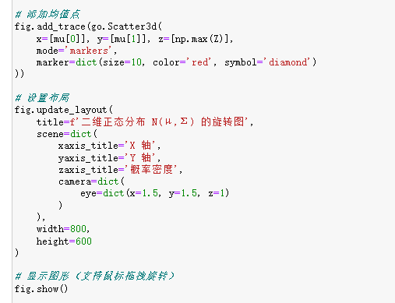
Code for creating a N( μ, Σ ) and its PDF rotating plot

Slide 10
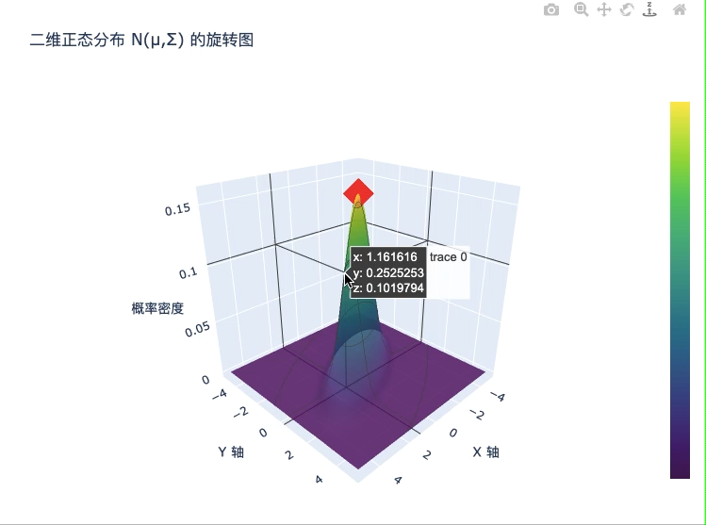
A Possibility Density Function plot for N( μ, Σ )

Slide 11
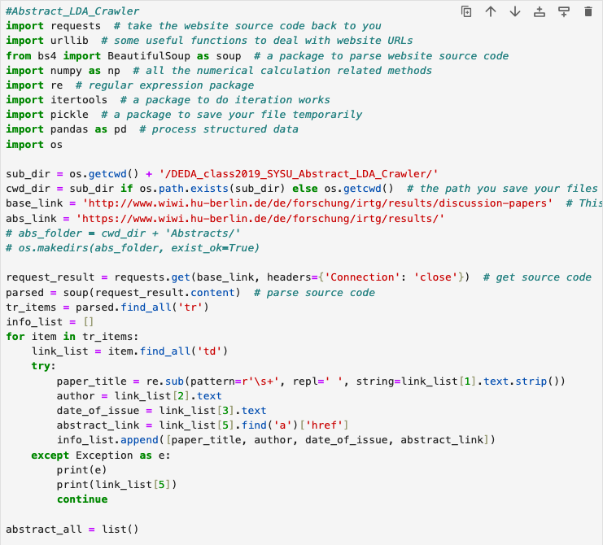
2. the LDA analysis example lRTG1792
Step1: web scraping

Slide 12
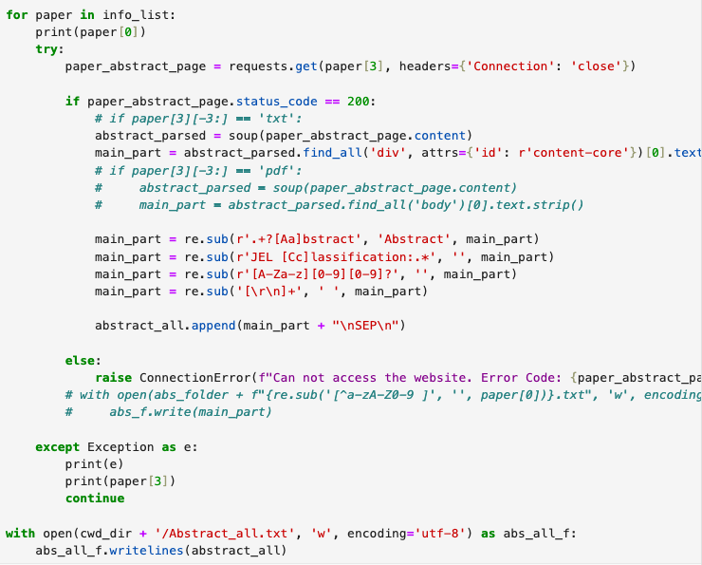
2. the LDA analysis example lRTG1792
Step1: web scraping

Slide 13
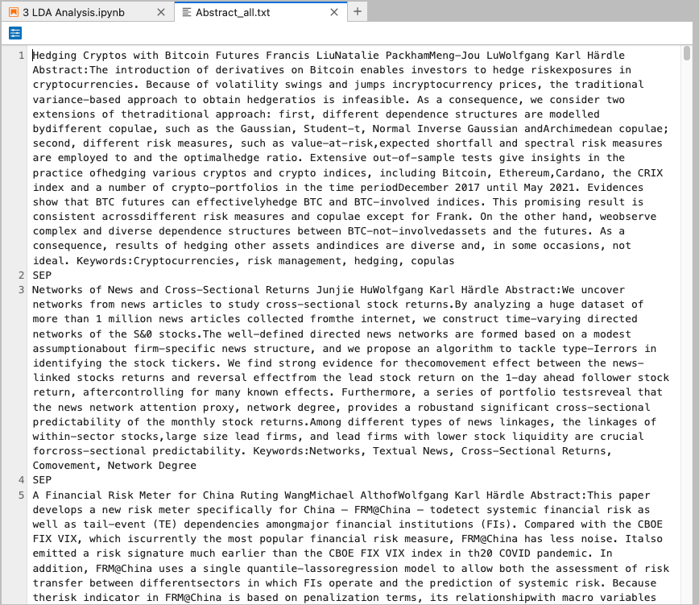
2. the LDA analysis example lRTG1792

Slide 14
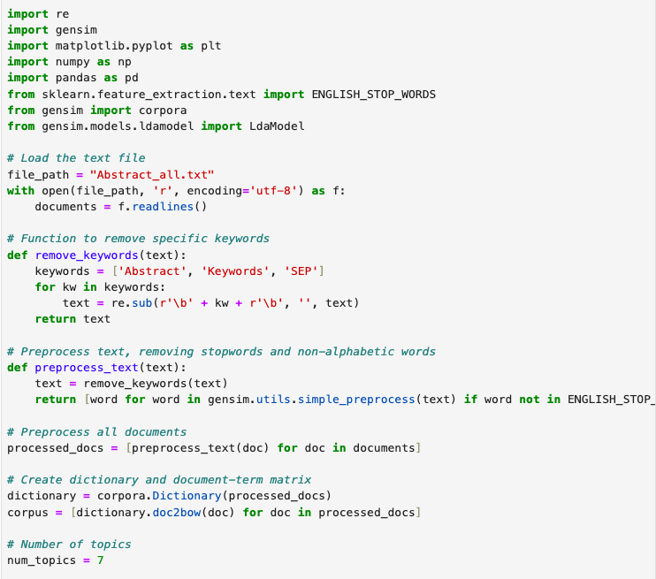
2. the LDA analysis example lRTG1792
Step2: heat map to find correlations and topics

Slide 15
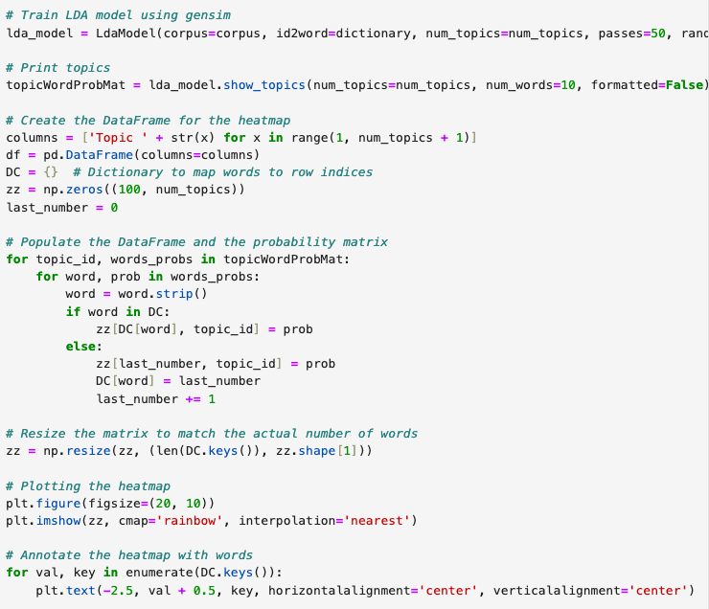
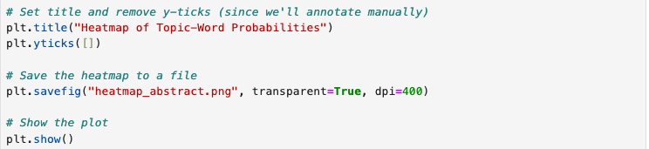
2. the LDA analysis example lRTG1792
Step2: heat map to find correlations and topics

Slide 16
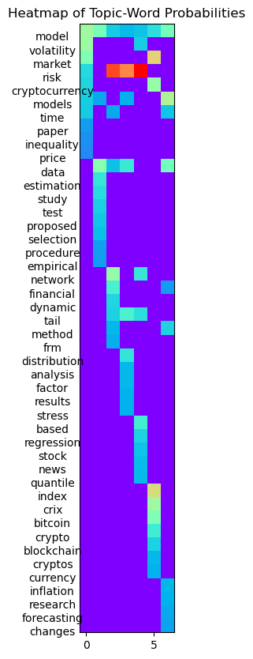
2. the LDA analysis example lRTG1792

Slide 17
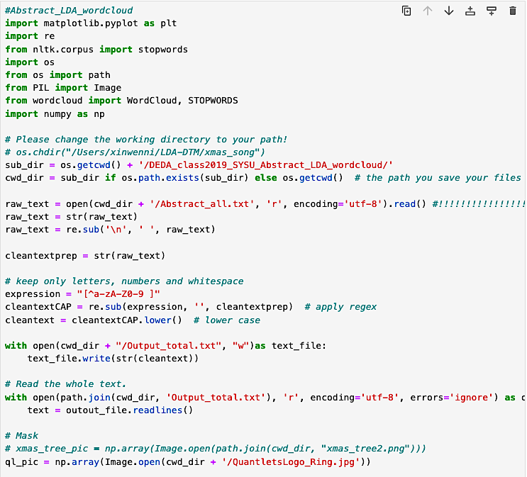
WordCloud of the LDA analysis example lRTG1792

Slide 18
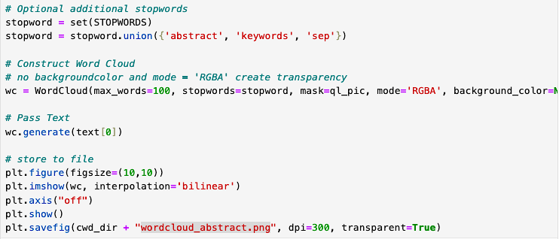
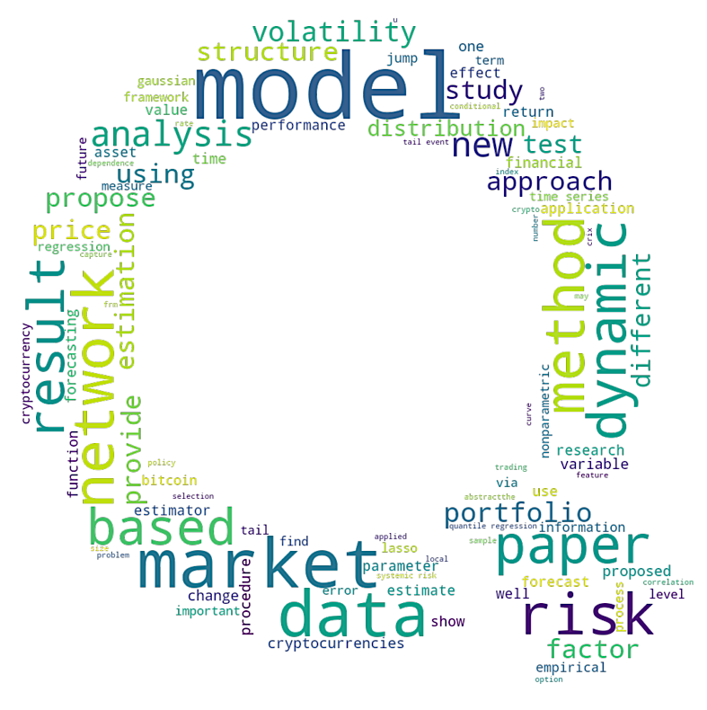
WordCloud of the LDA analysis example lRTG1792

